Slide 1
Practice Ques Tutorial

Slide 3
Ans = d

Slide 4
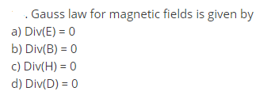

Slide 5
Ans = b

Slide 6
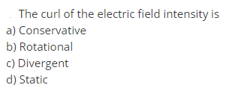

Slide 7
Ans = b

Slide 11
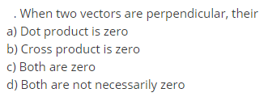

Slide 12
A. B = AB cos Q = 0

